Slide 1

Mini Project-I (K24MCA18P) Odd Semester Session 2024-25
Project title - Better Giving
Simran Tyagi - 2426mca2174
Shefali Yadav – 2426mca198
Trapti Rajput – 2426mca629
Project Supervisor:
Ms. Divya Singhal
Project Supervisor

Slide 2
Index
Introduction
Literature Review
Objective of the Project
Technology
Hardware Requirements
Software Requirements
Modules
Workflow
References
Notes:
Font Styles: Times New Roman + Font Size: 25

Slide 3


Introduction
In today's world, the need for compassion and community support has never been greater. "Better Giving" is an innovative web application designed to bridge the gap between donors and those in need. Our mission is to facilitate the donation of food and money, and other basic needs ensuring that every contribution makes a tangible impact on the lives of vulnerable individuals and families. One can easily donate their leftover food to NGOs by simply posting on this website.
Notes:
Font Styles: Times New Roman + Font Size: 25

Slide 4
Literature Review
Charitable giving has a profound impact on community welfare and individual well-being. It is the social responsibility that everyone should fulfill. The rise of digital platforms has transformed how donations are made, making it easier for individuals to contribute. It also provide a platform for people who are in need of money and food, they can apply for donations easily.
Food Donations and Hunger Relief
Food insecurity remains a critical issue globally. According to the UNICEF report, 8.8 lakh children under the age of five die due to starvation in 2018. Platforms that facilitate food donations play a vital role in connecting surplus food sources, such as restaurants and grocery stores, with local food banks and shelters.
Monetary Donations and Financial Support
Monetary donations provide vital resources for individuals and organizations in need. It empower beneficiaries by giving them the flexibility to choose their necessities . Platforms that enable seamless financial transactions and transparency in fund allocation have been shown to increase donor trust and engagement. Social media and crowdfunding mechanisms has revolutionized fundraising efforts, allowing for a broader reach and enhanced community involvement.1.6 million people die in India each year
Notes:
Font Styles: Times New Roman + Font Size: 25

Slide 5
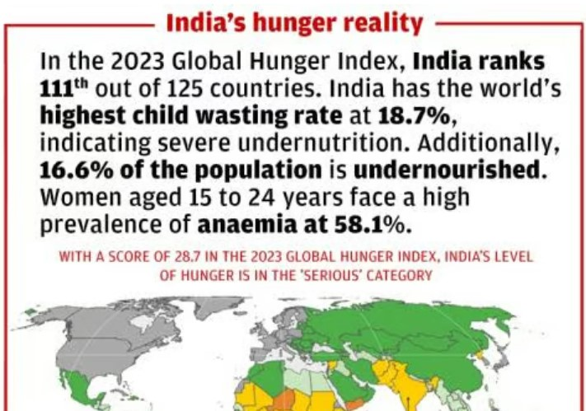
Literature Review (Contd.)
The Role of Technology in Charitable Giving
The integration of technology in charitable giving has led to the development of various online platforms that simplify the donation process. User-friendly interfaces and mobile accessibility are critical for encouraging participation. Data analytics can enhance donor engagement by providing insights into giving preferences, correct information.
Challenges and Opportunities
Despite the advantages of digital donation platforms, challenges such as donor fatigue, privacy concerns, and the need for effective outreach strategies remain a concern. Addressing these issues through innovative solutions and community-focused approaches can significantly enhance the effectiveness of donation programs, By providing the complete information.
Notes:
Font Styles: Times New Roman + Font Size: 25

Slide 6
Objective of the Project
Facilitate Donations: Create a user-friendly platform that simplifies the process of donating food and money to those in need.
Enhance Community Engagement: Connecting donors with recipients, encouraging local support and collaboration.
Ensure Transparency: Provide clear insights and build trust.
Empower Recipients: Enable recipients to express their needs.
Leverage Technology: Utilize data analytics and digital tools to enhance user experience, improve donation tracking, and optimize outreach efforts.
Raise Awareness: Educate the community about food insecurity and the importance of charitable giving through targeted campaigns and storytelling.
Notes:
Font Styles: Times New Roman + Font Size: 25

Slide 7
Technology (Hardware Requirements)
Server Requirements
Web Server: AWS EC2 to host the application.
Database Server: Reliable database server (e.g., MongoDB, PostgreSQL) with sufficient storage capacity for user data and donation records.
Client Devices
User Devices: Desktops, laptops, tablets, and smartphones to access the platform.
Admin Devices: Dedicated computers for administrators to manage the platform and monitor activities.
Networking Equipment
Router/Switch: Reliable networking hardware to ensure stable internet connectivity.
Firewall: Security appliance to protect the server and data from unauthorized access.
Backup Solutions
Cloud Storage: For regular backups of the database and application data to prevent data loss.
Development and Testing Machines
Developer Workstations: Computers with adequate processing power and memory for coding, testing, and debugging.
Testing Devices: Multiple devices (mobile, tablet, desktop) for testing the application's responsiveness and functionality across platforms.
Notes:
Font Styles: Times New Roman + Font Size: 25

Slide 8
Technology (Software Requirements)
Front-End Technologies – HTML, CSS, JavaScript, Frameworks/Libraries – React.js
Back-End Technologies – Node.js, Express.js,
Database Management System – MongoDB, SQL
Authentication and Security – JWT ( JSON Web Tokens)
Hosting and Deployment – Cloud Hosting services - AWS
Version Control – Git, GitHub
Development Tools - Integrated Development Environment (IDE) – V S code
Automated testing - Selenium
Notes:
Font Styles: Times New Roman + Font Size: 25

Slide 9
Modules
User Authentication Module
Registration: Allow users to sign up (donors, recipients, admins).
Login/Logout: Handle user sessions and authentication.
Profile Management: Enable users to update their information.
Donation Management Module
Create Donation: Form to submit food or monetary donations.
View Donations: List all donations made, with details.
Edit/Delete Donation: Options to modify or remove donations.
Recipient Management Module
Request for Assistance: Allow recipients to request food or funds.
View Requests: Admins can see all requests made by recipients.
Approve/Reject Requests: Admin functionality to manage requests.
Notes:
Font Styles: Times New Roman + Font Size: 25

Slide 10
Modules (Contd.)
Dashboard Module
Statistics Overview: Display total donations, active recipients, and other key metrics.
Recent Donations: Show recent activities to keep users informed.
Admin Panel Module
User Management: Manage users (view, edit, delete).
Donation Oversight: Review and manage donations and requests.
Reports: Generate reports on donations, user activity, and more.
Search and Filter Module
Search Functionality: Allow users to find specific donations or recipients.
Filter Options: Enable filtering by category (food, money) or location.
Notes:
Font Styles: Times New Roman + Font Size: 25

Slide 11
Modules (Contd.)
Notification Module
Email Notifications: Notify users about new donations, requests, or account activities.
In-app Notifications: Alert users to updates or changes in their requests or donations.
Feedback and Support Module
Contact Form: Allow users to reach out for support or inquiries.
Feedback System: Gather feedback on the platform's usability and features.
Security Module
Data Encryption: Ensure sensitive data is securely stored.
Input Validation: Validate user inputs to prevent attacks (e.g., SQL injection).
Notes:
Font Styles: Times New Roman + Font Size: 25

Slide 12
Workflow/Gantt Chart
User Registration and Login.
Dashboard Access
Making a Donation
Recipient Action
Admin Action
User Notifications
Notes:
Font Styles: Times New Roman + Font Size: 25

Slide 13
References
World Hunger Statistics
World Food Programme
www.google.com
Notes:
Font Styles: Times New Roman + Font Size: 25

